Slide 1
Beers and Brewery Data Analysis
Initial Discoveries
Presented by: Jasmine O’Neal and Connor Dobbs

Slide 2
Data Disclaimer
There were roughly 1000 missing IBU values for beers across the country
Three options considered on how to handle
Find missing values
Replace missing values with average
Remove from related analysis

Slide 3
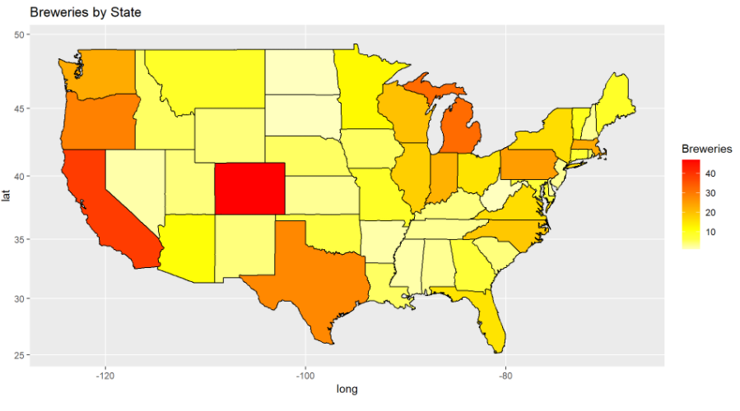
Breweries
Only 19 States had 10 or more unique breweries
Colorado has the most unique breweries at 47

Slide 4
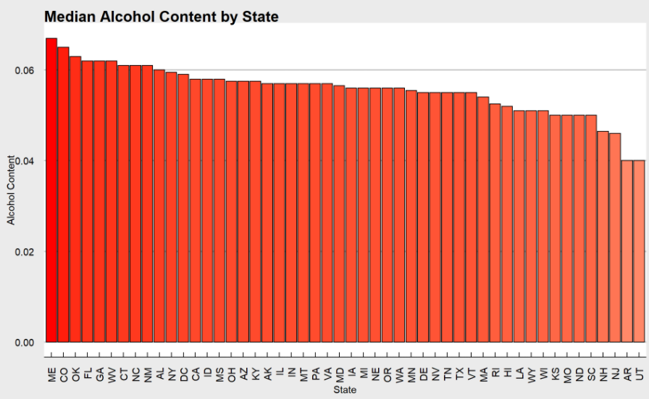
Median ABV State Trends
Median Alcohol content of beer varieties level between most states
Utah unsurprisingly the lowest due to legal limit of 4% by weight

Slide 5
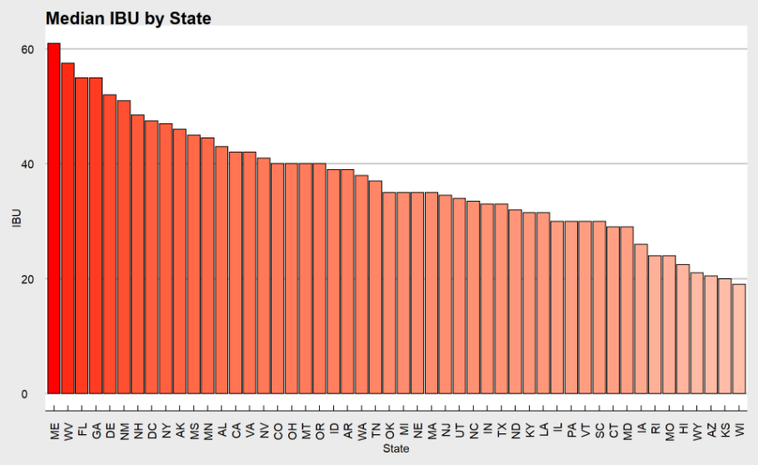
Median IBU State Trends
Larger variance than ABV
Maine has more than triple the median IBU than the lowest median state, Wisconsin

Slide 6
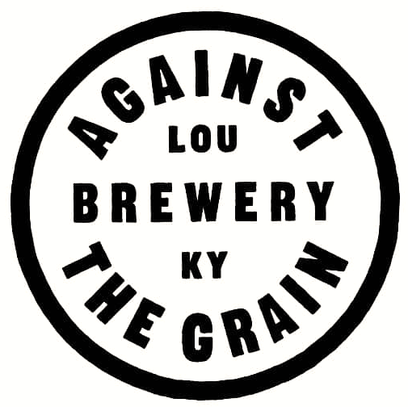
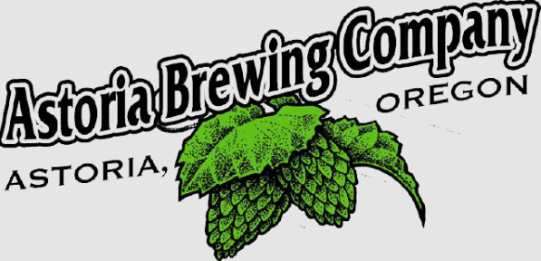
The Extremes
Against the Grain Brewery in Kentucky has the highest ABV beer offering at .125
Astoria Brewing Company in Oregon has the highest IBU beer offering at 138

Slide 7
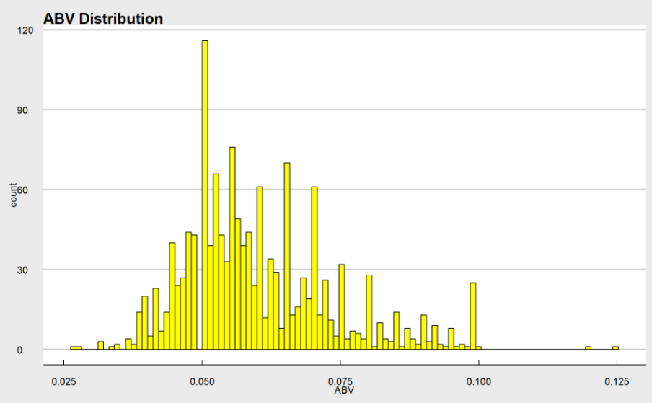
Alcohol Content Variability
Distribution is slightly right skewed
Median: .057 Mean: .059
Half of the values fall between .05 and .068
Lowest ABV: .027 Highest ABV: .125

Slide 8
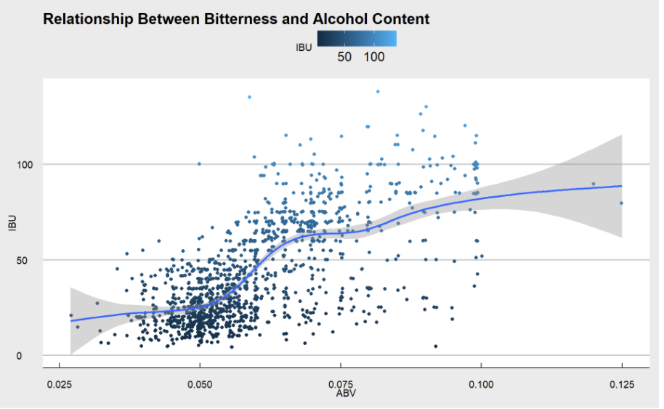
ABV vs IBU
Apparent correlation visible between ABV and IBU
As one increases the other tends to as well, particularly between an ABV of ~.05 and ~.08

Slide 9
Questions?

Slide 10
Sources
Logos from:
https://us.budweiser.com/
https://atgbrewery.com/
https://astoriabrewingcompany.com/

